Slide 1
Adaptive EMS Calibration
Using EEG-Based Deep Learning Classification
Methods & Results Summary
31
160
4
5
Participants
Trials / Subject
EMS Conditions
DL Models

Slide 2
What is this study about?
The Problem: EMS (Electrical Muscle Stimulation) delivers electrical currents to muscles. Tolerance levels differ hugely between people. Currently, calibration is done manually by trial and error, which is slow and inconsistent.
Goal
Approach
Why EEG?
Detect when EMS stimulation becomes intolerable using brain signals, so a computer system can automatically adjust the intensity in real time.
Record EEG (brainwaves) while participants receive EMS at 4 levels: no stimulation, minimum, medium, and maximum intensity.
EEG captures the brain's immediate response to stimulation non-invasively from the scalp in real time.

Slide 3
Experiment Design
4 EMS Conditions
Trial Timeline
S4 — No Stimulation
Rest period
EMS stimulation
Post-stim window
Self-report
Sham / Baseline
2.5–3.5 s
(randomised)
1 s
0.5 s
1–3 s
(S5–S9)
S1 — Minimum Intensity
← Epoch window for analysis: −2.0 s to +1.5 s →
Just perceivable
Setup & Protocol
S2 — Medium Intensity
Clearly perceivable
EEG Cap:
64-channel BrainProducts system, CACS-64 montage, FCz online reference
EMS Device:
Teslasuit delivering calibrated current to left hand
S3 — Maximum Intensity
Intolerable / painful
Staircase Protocol:
Part 1 identifies each participant's personal thresholds
40 trials per condition · 160 total per subject · 31 subjects
Main Task:
Part 2 presents 160 randomised trials across the 4 conditions

Slide 4
EEG Preprocessing Pipeline
1
Load Raw Data
5
Notch Filter 50 Hz
Read .vhdr/.eeg/.vmrk BrainVision files via MNE-Python..
Remove power-line interference
2
Drop Channels
6
Re-reference (CAR)
Remove 4 peripheral electrodes (FT9, FT10, TP9, TP10).
Recover the FCz online reference electrode, then apply Common Average Reference
Band-pass Filter 1–100 Hz
7
Epoch + Baseline Correct
4
Remove slow drift (< 1 Hz) and high-frequency noise (> 100 Hz).
Cut 160 clips of −2.0 s to +1.5 s around each EMS marker. Apply baseline correction using −0.7 s to −0.2 s window.
Output: X matrix (n_epochs × 60 channels × 750 time-points) + y vector (0 = no stim · 1 = min · 2 = medium · 3 = max)

Slide 5
Classification Methodology
Within-Subject Paradigm: A completely separate model is trained for each participant. This is essential because EMS tolerance is deeply personal (what is painful for one person may feel mild to another).
EEGNet
ShallowNet
EEGNetv4 (braindecode)
ShallowFBCSPNet (braindecode)
What it does: A compact convolutional neural network designed specifically for EEG. Uses depthwise convolutions to learn spatial patterns across electrodes, then temporal patterns across time.
What it does: A shallow convolutional network that applies a single temporal convolution followed by a spatial filter, inspired by classical EEG signal processing (FBCSP).
Why chosen: Works well with limited data (160 trials). Widely used as a benchmark in EEG classification research.
Why chosen: Captures oscillatory EEG features in specific frequency bands. Strong for motor and sensory paradigms.
Cross-Validation & Training
Repeated Stratified K-Fold: 5 folds × 5 repeats = 25 total evaluations per model per subject
Baseline removal before input: only the 0 s → +1.5 s window is fed to the classifier
Z-score normalisation computed from training data only
Early stopping: training halts if validation loss does not improve for 15 consecutive epochs

Slide 6
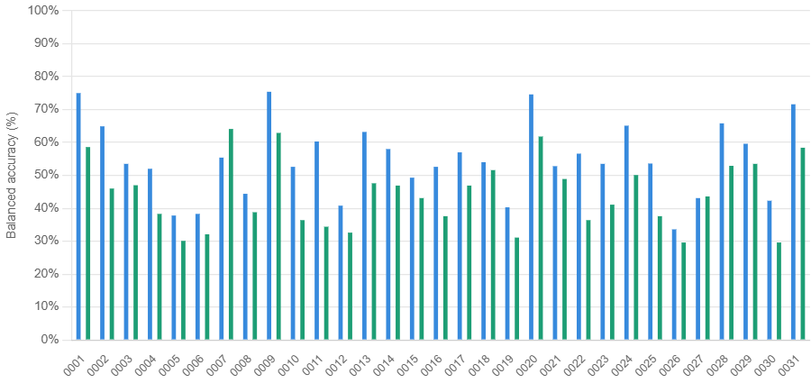
Results Overview (EEGNet and ShallowNet)
54.7%
44.2%
22 / 31
29 / 31
EEGNet group mean
ShallowNet group mean
Subjects above 50%
EEGNet wins
Chance = 25%
Chance = 25%
using EEGNet
vs ShallowNet
EEG Net
ShallowNet
25% chance

Slide 7
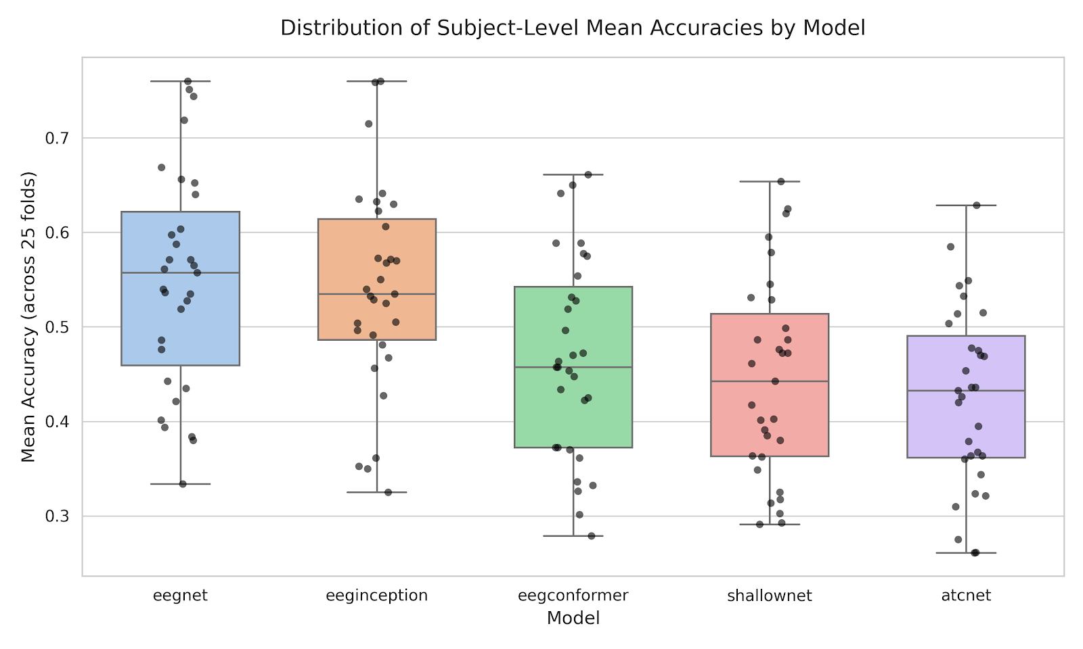
Results Overview
EEGNet
EEGInception
EEGConformer
ShallowNet
ATCNet
54.9%
53.9%
46.7%
44.4%
42.6%
±11.4% across subjects
±10.8% across subjects
±10.4% across subjects
±10.4% across subjects
±9.4% across subjects

Slide 8
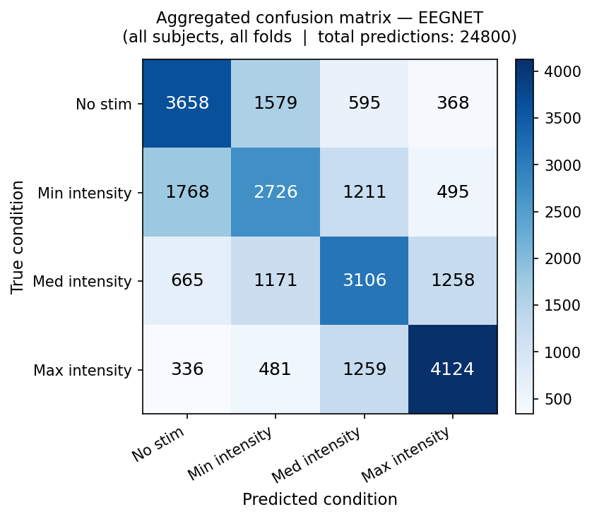
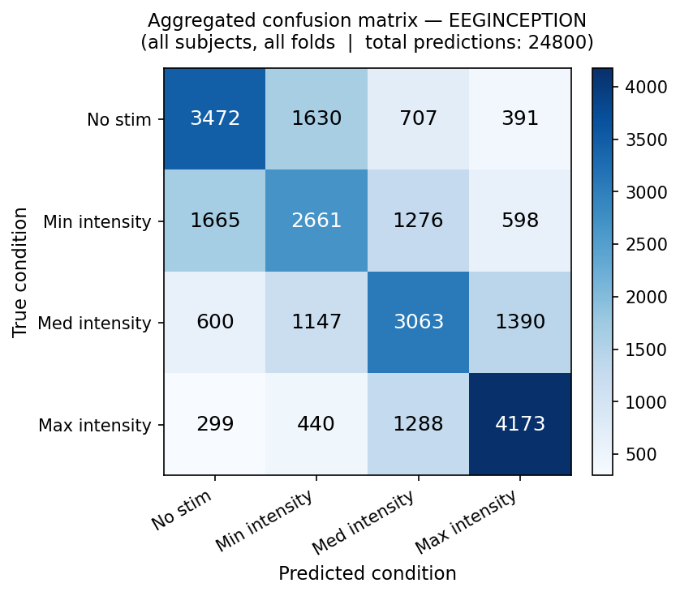
Results Overview
Confusion Matrix

